Slide 1
User Interface Design
Findings & Observations

Slide 2
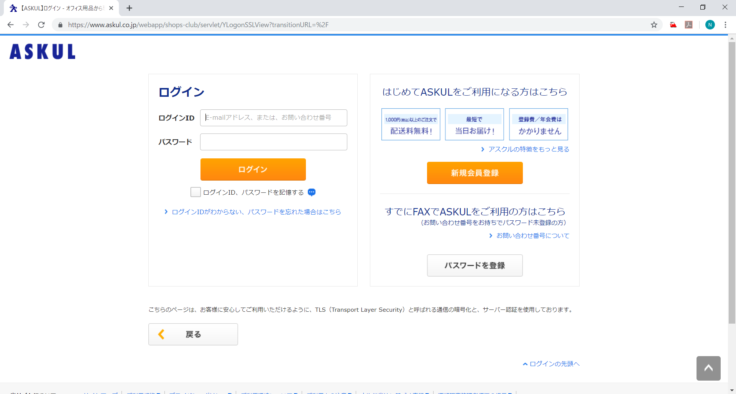
Login Page
1
3

Slide 3
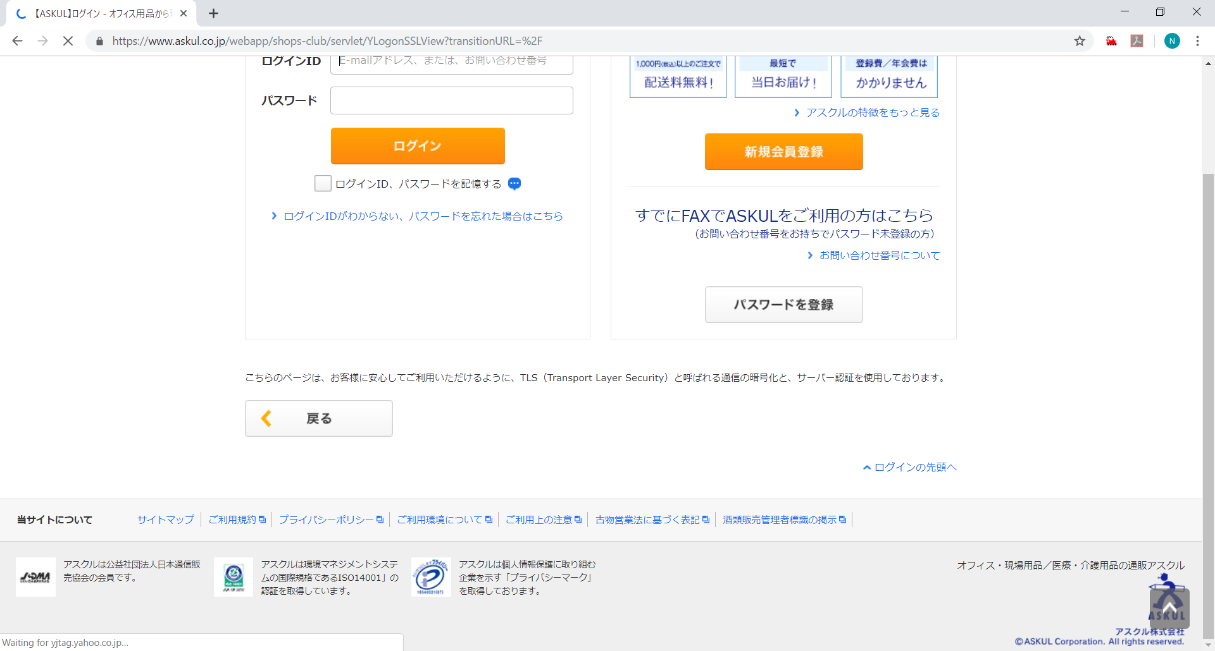
Login Page
7
9
2, 3

Slide 4
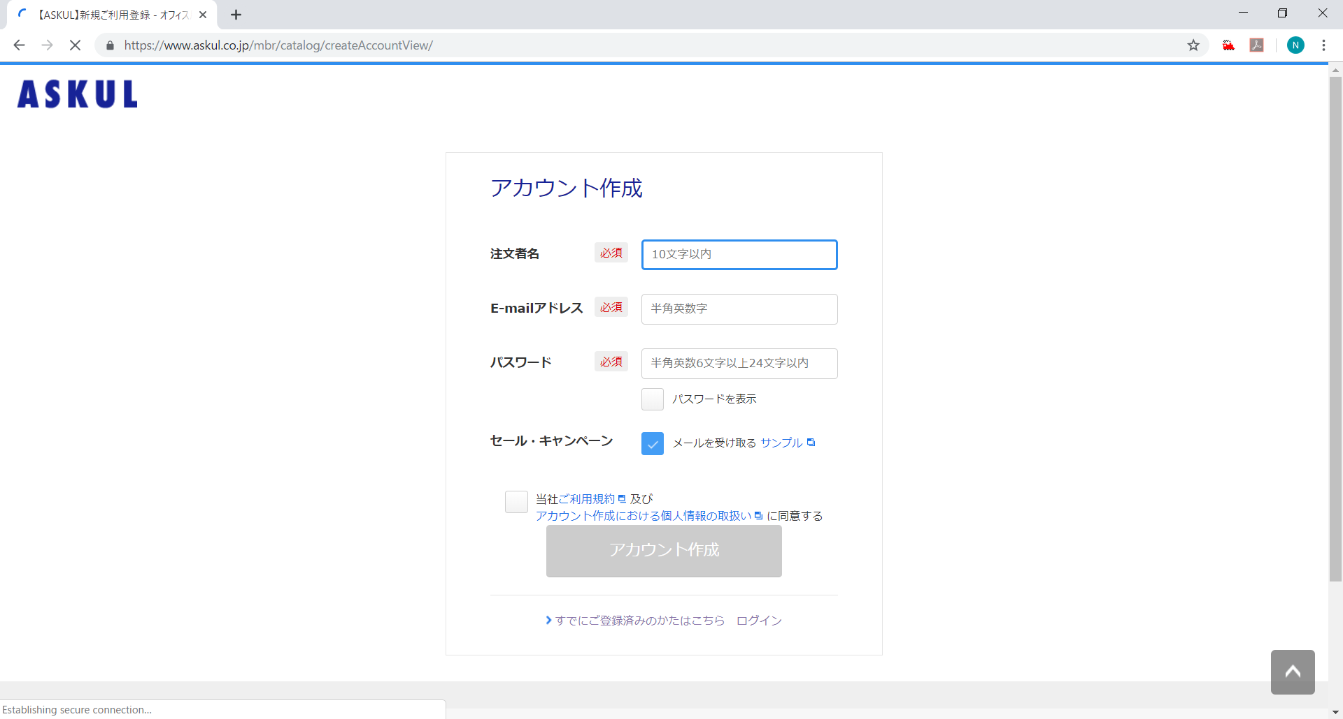
New Account Register
5
6
4
8

Slide 5
What Looks Good in Login & Register Page
Header has only Site Logo
Footer has only site map and some general menus
Footer is in dark grey background color
Labels are displayed in Bold Black Color
Mandatory fields are shown as “必須”
When input field is selected, its border changed to Blue Color
Buttons in Orange color background
Button gets enabled only if all the mandatory fields are filled
Back button is also provided

